Slide 1
NEXT HIKES PROJECT
Telcom Data Analysis
By : Shyam Kumar Singh

Slide 2
Handset Analysis
Huawei B528S-23A 19752
Apple iPhone 6S (A1688) 9419
Apple iPhone 6 (A1586) 9023
undefined 8987
Apple iPhone 7 (A1778) 6326
Apple iPhone Se (A1723) 5187
Apple iPhone 8 (A1905) 4993
Apple iPhone Xr (A2105) 4568
Samsung Galaxy S8 (Sm-G950F)4520
Apple iPhone X (A1901) 3813

Slide 3
Top 3 Handset Manufacturers
Apple - 59565
Samsung - 40839
Huawei - 34423

Slide 4
Top 5 Handsets per Manufacturer
*Apple *Huawei
Apple iPhone 6S (A1688) 9419 Huawei B528S-23A
Apple iPhone 6 (A1586) 9023 Huawei E5180 2079
Apple iPhone 7 (A1778) 6326 Huawei P20 Lite Huawei Nova 3E 2021
Apple iPhone Se (A1723) 5187 Huawei P20 1480
Apple iPhone 8 (A1905) 4993 Huawei Y6 2018 997
*Samsung
Samsung Galaxy S8 (Sm-G950F) 4520
Samsung Galaxy A5 Sm-A520F 3724
Samsung Galaxy J5 (Sm-J530) 3696
Samsung Galaxy J3 (Sm-J330) 3484
Samsung Galaxy S7 (Sm-G930X) 3199

Slide 5
Interpretation and Recommendations
1. Promote Popular Handsets:
Highlight the Huawei B528S-23A, Apple iPhones, and Samsung Galaxy devices in marketing campaigns.
Showcase the features and benefits to attract more customers.
2. Collaborate with Top Manufacturers:
Establish partnerships with Apple, Samsung, and Huawei to leverage their market dominance.
Explore joint marketing initiatives, exclusive offers, or special promotions to boost sales.
3. Investigate Undefined Handsets:
Conduct further investigation to clarify the nature of undefined handsets.
Identify whether they are new models, discontinued devices, or data entry errors.

Slide 6
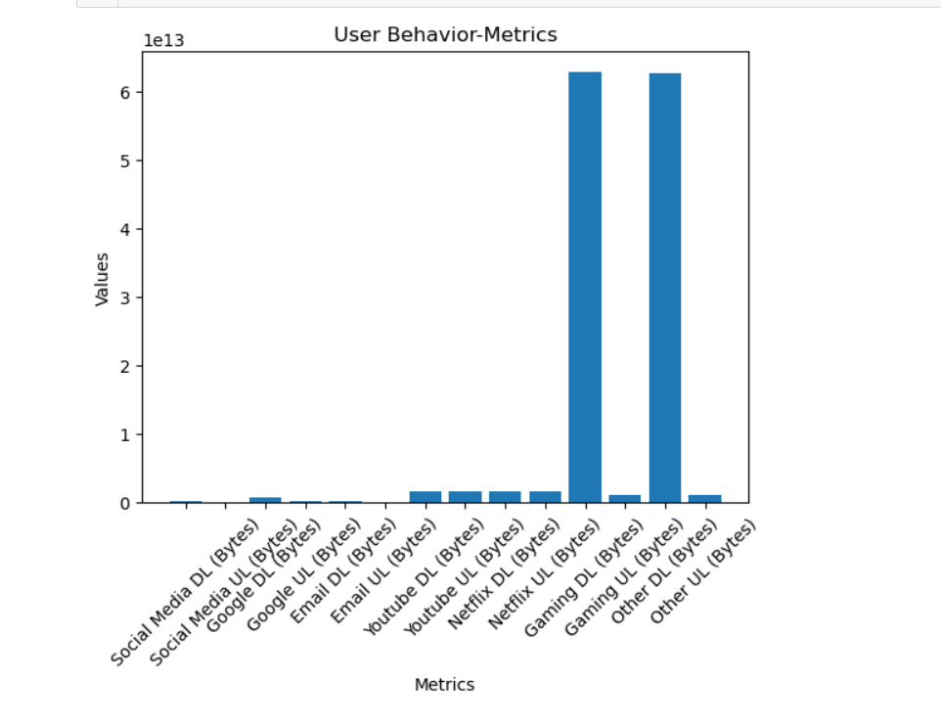
User Behaviour Analysis
Purpose: Analysing user behaviour based on aggregated data.
Dataset: Raw data containing user-specific metrics.
Data Aggregation
Individual app data usage:
Social Media, Google, Email, Youtube, Netflix,
Gaming, Other

Slide 7
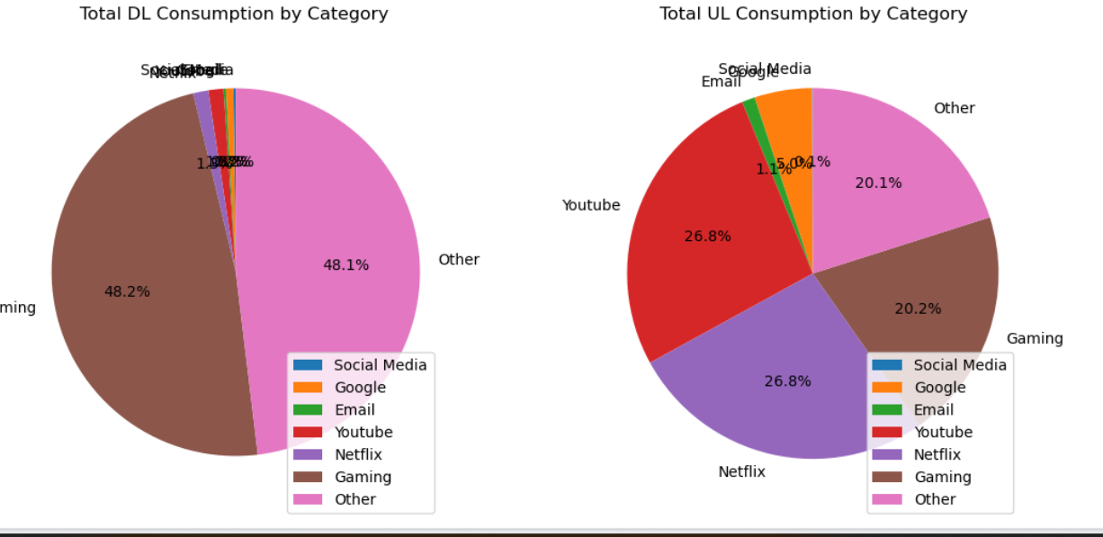
Resulting User Behaviour DataFrame
Key insights:
1. Session count and duration.
2. Overall data usage (download and upload).
3. App-specific data usage patterns.
Conclusion:
1.User behaviour analysis provides valuable insights into data usage patterns.
2.Helps identify popular applications and user preferences
Overview of aggregated metrics for each user

Slide 8
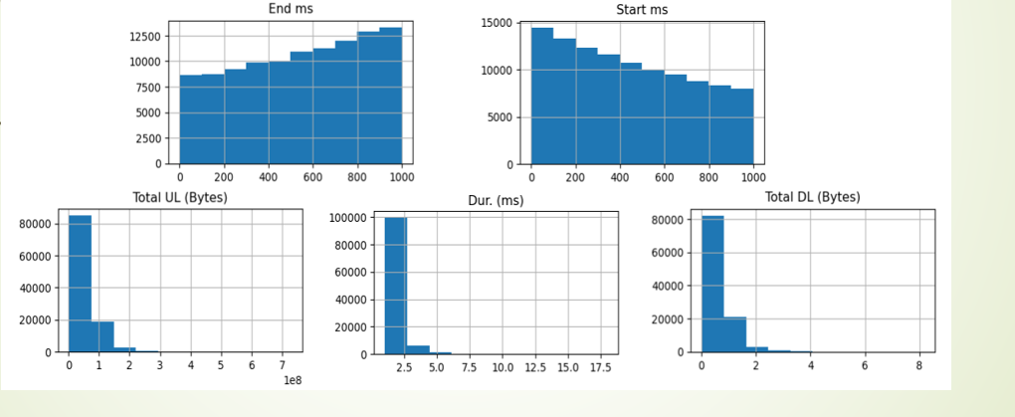
Graphical Univariate Analysis
Purpose of graphical univariate analysis
Interpretation of histograms and their significance.

Slide 9
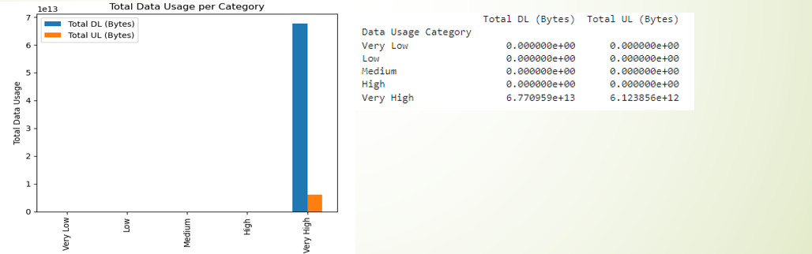
Bivariate Analysis by Data Usage Category
Variables under analysis: "Total DL (Bytes)" and "Total UL (Bytes)".
Grouping by "Data Usage Category".
Output interpretation for each category.

Slide 10
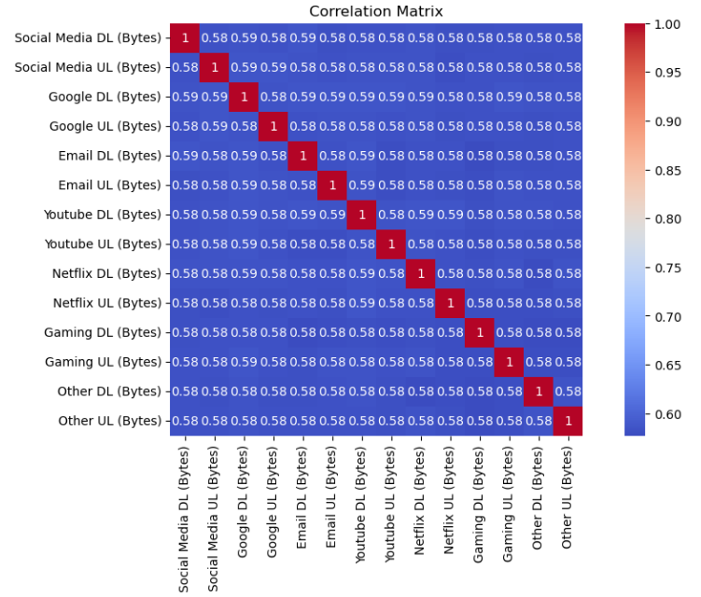
Correlation Matrix

Slide 11
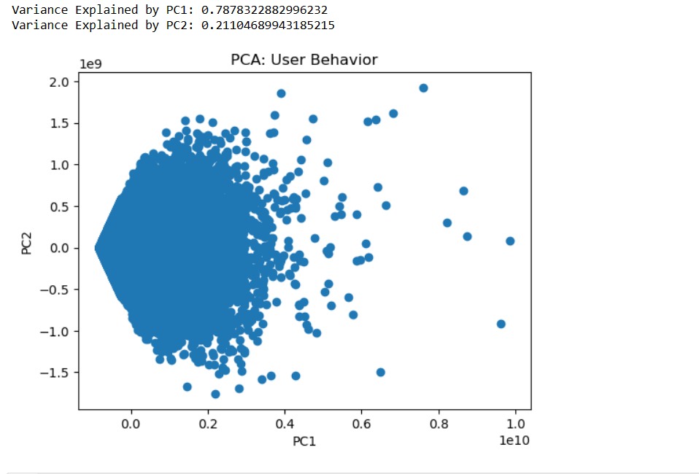
Principal Component Analysis (PCA) Results

Slide 12
THANK YOU

